Slide 1
Fast Exhaustive Search for Polynomial Systems in F₂
Theoretical and Practical Perspectives
Tung Chou

Slide 2
Introduction
Motivation
Problem Definition
Contribution
Algorithm
Naïve Evaluation
Basic Gray Code Enumeration
Generalized Gray Code Enumeration
Partial Evaluation
Variants★
Early Abort Strategy
Gaussian Elimination
Implementation
On nVidia GPUs, with CUDA
On x86-64 CPUs, with SSE2 Intrinsics
Experiment Results
Conclusion

Slide 3
Motivation
The problem of solving non-linear polynomial systems in finite fields Is highly related to various fields
Algebraic Cryptanalysis
Multivariate Cryptography
Solving Polynomial Systems
Pure Mathematics
Graph Coloring

Slide 4
Motivation
Existing Solvers (XL, F₄/F₅, etc)
Efficient for systems with defects, but not for generic systems
Do not take exhaustive-search approach
Notes:
Should give concrete argument

Slide 5
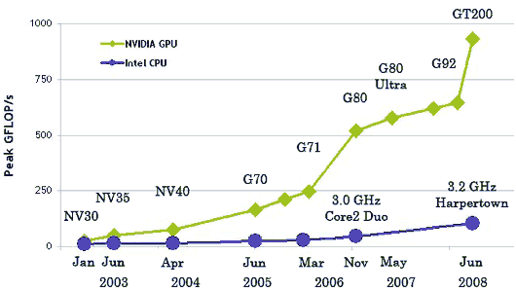
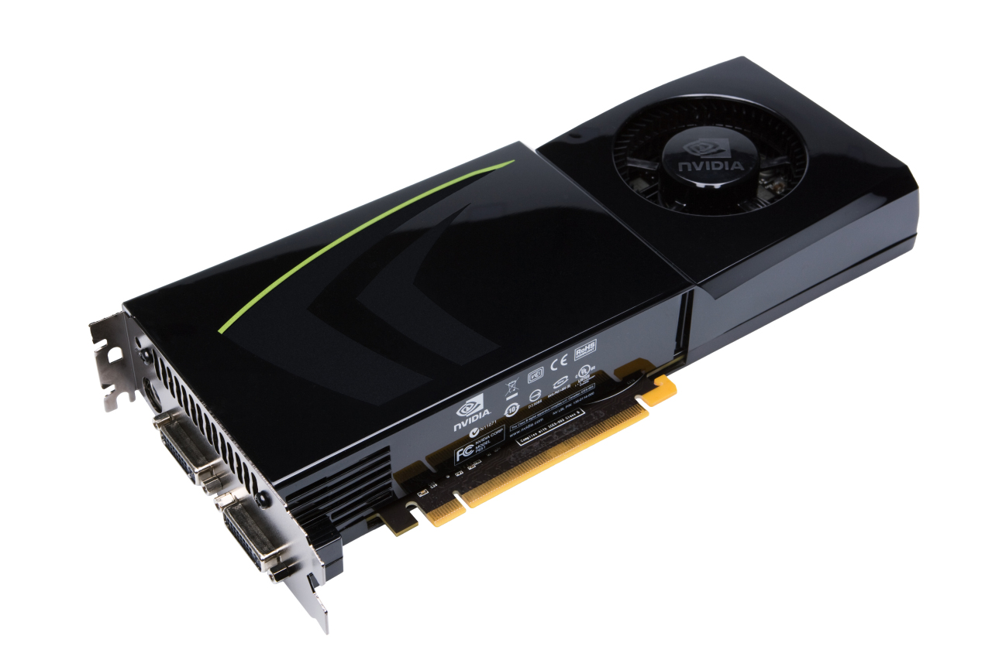
Motivation
“Parallel computing has become the dominant paradigm
of computer architecture.”
MP
SP | SP
SP | SP
SP | SP
SP | SP
MP
SP | SP
SP | SP
SP | SP
SP | SP
MP
SP | SP
SP | SP
SP | SP
SP | SP
MP
SP | SP
SP | SP
SP | SP
SP | SP
MP
SP | SP
SP | SP
SP | SP
SP | SP
MP
SP | SP
SP | SP
SP | SP
SP | SP
MP
SP | SP
SP | SP
SP | SP
SP | SP
MP
SP | SP
SP | SP
SP | SP
SP | SP
MP
SP | SP
SP | SP
SP | SP
SP | SP
MP
SP | SP
SP | SP
SP | SP
SP | SP
MP
SP | SP
SP | SP
SP | SP
SP | SP
MP
SP | SP
SP | SP
SP | SP
SP | SP
MP
SP | SP
SP | SP
SP | SP
SP | SP
MP
SP | SP
SP | SP
SP | SP
SP | SP
MP
SP | SP
SP | SP
SP | SP
SP | SP
MP
SP | SP
SP | SP
SP | SP
SP | SP
MP
SP | SP
SP | SP
SP | SP
SP | SP
MP
SP | SP
SP | SP
SP | SP
SP | SP
MP
SP | SP
SP | SP
SP | SP
SP | SP
MP
SP | SP
SP | SP
SP | SP
SP | SP
MP
SP | SP
SP | SP
SP | SP
SP | SP
GTX280
MP
SP | SP
SP | SP
SP | SP
SP | SP
MP
SP | SP
SP | SP
SP | SP
SP | SP
MP
SP | SP
SP | SP
SP | SP
SP | SP
MP
SP | SP
SP | SP
SP | SP
SP | SP
MP
SP | SP
SP | SP
SP | SP
SP | SP
MP
SP | SP
SP | SP
SP | SP
SP | SP
MP
SP | SP
SP | SP
SP | SP
SP | SP
MP
SP | SP
SP | SP
SP | SP
SP | SP
MP
SP | SP
SP | SP
SP | SP
SP | SP

Slide 6
Introduction
Motivation
Problem Definition
Contribution

Slide 7
Problem Definition
Solving a non-linear, generic system with
# Equations | m
# Variables | n
Degree | d
In F₂
Actually we can solve systems in GF(2^{k})

Slide 8
Problem Definition
a general form
Known to be NP-hard
Notes:
NP-hard

Slide 9
Contribution
Theoretical side
We proposed a new algorithm based on exhaustive search
along with several variants of it
We perform analysis on theoretical performance, memory consumption and adjustable variables
Practical side
We implemented the algorithm for quadratic, cubic, and quartic systems on both GPUs and CPUs
Our implementation outperforms Magma F₄ in practical case
Notes:
表格要改

Slide 10
Contribution
algorithm | platform | m | n | d | time
GGCE | GPU | 48 | 48 | 3 | 36 mins
F₄ | CPU | 30 | 20 | 3 | 31 mins
times faster !!!
Notes:
表格要改

Slide 11
Algorithms
Naïve Evaluation
Basic Gray Code Enumeration (BGCE)
Generalized Gray Code Enumeration (GGCE)
Partial Evaluation

Slide 12
Naive Evaluation
Just evaluate f(v) for all vector in (F₂)^{n} directly
Multivariate Horner’s Rule:
This is not necessarily the best method

Slide 13
Naive Evaluation
#(Bit operations) to compute :
#(Bit operations) to compute :
Complexity: if d is considered as a constant

Slide 14
Algorithms
Naive Evaluation
Basic Gray Code Enumeration (BGCE)
Generalized Gray Code Enumeration (GGCE)
Partial Evaluation

Slide 15

Basic Gray Code Enumeration
?
Intuition: if the two vectors are “close”…

Slide 16
Basic Gray Code Enumeration
Two vectors are i-close w.r.t. f if they
differs only in the i-th bit w.r.t. f
Definition
irrelevant
Example
3-close
Can refer to a sequence of vectors

Slide 17
Basic Gray Code Enumeration
Let be -close w.r.t. ,
then
Proposition

Slide 18
index | code | b₁(i) | b₂(i)
0000 | 0000 | -1 | -1
0001 | 0001 | 0 | -1
0010 | 0011 | 1 | -1
0011 | 0010 | 0 | 1
0100 | 0110 | 2 | -1
0101 | 0111 | 0 | 2
0110 | 0101 | 1 | 2
0111 | 0100 | 0 | 1
1000 | 1100 | 3 | -1
1001 | 1101 | 0 | 3
1010 | 1111 | 1 | 3
1011 | 1110 | 0 | 1
1100 | 1010 | 2 | 3
1101 | 1011 | 0 | 2
1110 | 1001 | 1 | 2
1111 | 1000 | 0 | 1
4-bit Gray Code

Slide 19
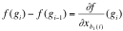
Basic Gray Code Enumeration
The enumeration now follows
the order of Gray code
Gray Code is close w.r.t.
To be exact, are -close

Slide 20
Basic Gray Code Enumeration
An attempt

Slide 21
Basic Gray Code Enumeration
Cost for each attempt has been reduced
#(Bit operations) to compute :
Complexity: if d is considered as a constant

Slide 22
Algorithms
Naive Evaluation
Basic Gray Code Enumeration (BGCE)
Generalized Gray Code Enumeration (GGCE)
Partial Evaluation

Slide 23
Generalized Gray Code Enumeration
?
We can use the same technique recursively
Notes:
The functions are different!

Slide 24
Generalized Gray Code Enumeration
Is the sequence of vectors close w.r.t. ?
Notes:
強調 recursive

Slide 25
Generalized Gray Code Enumeration
An attempt

Slide 26
Generalized Gray Code Enumeration
close w.r.t.
-close

Slide 27
Quadratic
An attempt

Slide 28
Generalized Gray Code Enumeration
close w.r.t.
-close

Slide 29
Cubic
An attempt

Slide 30
Generalized Gray Code Enumeration
Each attempt is composed of 3 components
Indexing
d
Computing
Testing

Slide 31
Generalized Gray Code Enumeration
#(Bit operations) for GGCE (for 1 equation):
we ignore this in this presentation★
Complexity:
 | Naïve eval. | BGCE | GGCE
Complexity

Slide 32
Generalized Gray Code Enumeration
GGCE is made for bit slicing
0
1
0
0
1
1
0
1
1
1
0
0
1
1
0
0
1
1
0
1
0
1
0
0
0
1
1
0
1
1
0
1
1
1
0
1
0
1
1
0
0
1
0
1
0
1
0
0
m
coefficients
Runtime variables
Notes:
少用術語?!

Slide 33
Algorithms
Naive Evaluation
Basic Gray Code Enumeration (BGCE)
Generalized Gray Code Enumeration (GGCE)
Partial Evaluation

Slide 34
Partial Evaluation
Divide a system into some smaller ones
Originated in the need of parallelization
GGCE as major subroutine

Slide 35
Partial Evaluation
Substitute all possible values of s variables
Usually
Resulting in 2^{s} subsystems with n-s variables

Slide 36
Partial Evaluation
Example (n=4, d=2, s=2):
constant
linear
linear
quadratic
Thus, partial evaluation can be done with GGCE

Slide 37
Partial Evaluation
Substitute all possible values of s variables
d
≤d-1
d
Usually
Common part
≤ d-1
≤ d-1
≤ d-1
≤ d-1
Resulting in 2^{s} subsystems with n-s variables

Slide 38
Variants
Early Abort Strategy
Naïve evaluation
GGCE★
Gaussian Elimination★

Slide 39
Naïve Evaluation with Early Abort Strategy
Each vector is filtered out
with probability 1/2
V⁽⁰⁾=(F₂)^{n}
f⁽⁰⁾
Each vector is examined by
about 2 filters on average
V⁽¹⁾
Total #(bit operations):
f⁽¹⁾
V⁽²⁾
f⁽²⁾

Slide 40
Implementation
On nVidia GPUs, with CUDA
Flow Path
Register Usage
Unrolling
Testing with Fast Conditional Move
On x86-64 CPUs, with SSE2 Intrinsics

Slide 41
Flow Path
Partial Eval. + GGCE
32
Sols
Naïve Eval.
32

Slide 42
Flow Path
Step 5.
Check for the
remaining equations
CPU
Step 1.
Partial Eval.
f⁽⁰⁾ ~ f⁽³¹⁾
d
≤d-1
≤d-1
≤d-1
≤d-1
Sols
Step 2.
Mem copy
Step 4.
Mem copy back
d
≤d-1
≤d-1
≤d-1
≤d-1
Sols
Constant Memory
Global Memory
MP
SP | SP
SP | SP
SP | SP
SP | SP
MP
SP | SP
SP | SP
SP | SP
SP | SP
MP
SP | SP
SP | SP
SP | SP
SP | SP
Step 3.
GGCE for each thread
GPU
Notes:
* Each thread returns at most 1 sol

Slide 43
Flow Path
bit slicing for GGCE
0
1
0
0
1
1
0
1
1
1
0
0
1
1
0
0
1
1
0
1
0
1
0
0
0
1
1
0
1
1
0
1
1
1
0
1
0
1
1
0
0
1
0
1
0
1
0
0
32
coefficients
Runtime variables
Solve 32 equations by GGCE to fit the size of registers

Slide 44
Register Usage
Problem
Scarcity of registers can be a serious problem when d>2
Our Solution
Save the registers for the most frequently used variables. In other words, we do caching.
But why should it necessarily work well?

Slide 45
Register Usage
There exists strong bias in probabilities of
accessing each differential
Diff type | amount | portion (n=16) | probability
d_{i,j} | 36 | 0.30 | 0.98
d_{i,j,k} | 35 | 0.06 | 0.77

Slide 46
Unrolling
Indexing can induce much overhead in each attempt
Indexing
Computing
Testing
Indexing
Computing
Computing
Testing
Testing
1 attempt
2^{u} attempts
This technique is also used in our implementation on CPUs.

Slide 47
Unrolling
index | b₄ | b₃ | b₂ | b₁
*…* 000 | β₄ | β₃ | β₂ | β₁
*…* 001 | β₃ | β₂ | β₁ | 0
*…* 010 | β₃ | β₂ | β₁ | 1
*…* 011 | β₂ | β₁ | 1 | 0
*…* 100 | β₃ | β₂ | β₁ | 2
*…* 101 | β₂ | β₁ | 2 | 0
*…* 110 | β₂ | β₁ | 2 | 1
*…* 111 | β₁ | 2 | 1 | 0
unroll factor = 8
Code generator is essential
for implementation.

Slide 48
Testing with Fast Conditional Move
We found that GPU can handle conditional (predicate) move instructions with exceptional adeptness
multiprocessor (MP)
SP
SP
Conditional Move
if( a == 0 ) b = c;
SP
SP
SP
SP
SP
SP
SFU
SFU
4 Cond. Mov per cycle ?

Slide 49
Testing with Fast Conditional Move
if( res == 0 ) y = z;
if( res == 0 ) z = code71;
part of candidate vector
y
z
Queue-like
movement
2+ solutions
1 solutions
0 solutions

Slide 50
Implementation
On nVidia GPUs, with CUDA
On x86-64 CPUs, with SSE2 Intrinsics

Slide 51
On x86-64 CPUs, with SSE2 intrinsics
Partial Eval. + GGCE
16
batched
Partial Eval. + (Naïve Eval. + Early Abort)
16
Naïve Eval.
32

Slide 52
On x86-64 CPUs, with SSE2 intrinsics
Running 8 instances of GGCE at the same time
with (128-bit) XMM registers
16
bits
coefficients
Runtime variables

Slide 53
On x86-64 CPUs, with SSE2 intrinsics
Mask = _mm_cmpeq_epi16(res, zero);
mask = _mm_movemask_epi8(Mask);
if(mask) check(mask, idx, 221);
branch away
0
0
0
0
0
0
0
0
0
0
1
0
0
0
0
0
0
0
1
0
0
0
0
0
cmpeq
movemask
128
bits
16
bits
Notes:
指令不用說明

Slide 54
On x86-64 CPUs, with SSE2 intrinsics
filtering takes place once 128 candidate vectors
are collected
Buffer
Buffer
Buffer
f ^{(i)}
f ^{(i)}
f ^{(i)}

Slide 55
On x86-64 CPUs, with SSE2 intrinsics
filtering takes place once 128 candidate vectors
are collected
1
1
1
1
1
1
1
1
0
0
0
0
0
0
0
0
1
1
0
1
1
1
0
0
1
0
0
1
0
1
1
0
1
0
1
1
0
1
1
1
128
Coefficients of
Candidate vectors

Slide 56
Experiment Results

Slide 57
Experiment Results
Notes:
圖

Slide 58
Experiment Results
Scalability w.r.t. n
Notes:
折線圖

Slide 59
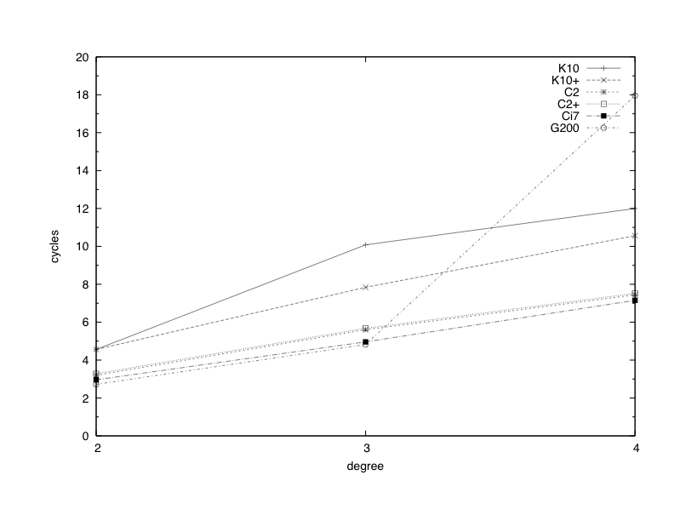
Experiment Results

Slide 60
Conclusion
Contributions
We proposed a new exhaustive search algorithm.
It can be inferred that GGCE should outperform
existing solvers as long as
Future Work
Programming in assembly code
On FPGA or ASIC

Slide 61
Thanks for your attention !
Questions or comments ?

Slide 62
Generalized Gray Code Enumeration
Definition
k can be 0
Example
Index
0000 1101
0001 1101
0010 1101
0011 1101
0100 1101
0101 1101
Gray Code
0000 1011
0001 0011
0011 1011
0010 0011
0110 1011
0111 0011

Slide 63
Generalized Gray Code Enumeration
Proposition
is close w.r.t.
are b_{k+1}(i)-close
Holds even when k=0

Slide 64
Generalized Gray Code Enumeration
is close w.r.t.
example
are b₄(i)-close
Index
0000 1101
0001 1101
0010 1101
0011 1101
0100 1101
0101 1101
Gray Code
0000 1011
0001 0011
0011 1011
0010 0011
0110 1011
0111 0011

Slide 65
Generalized Gray Code Enumeration
close w.r.t.
-close

Slide 66
An attempt

Slide 67
GGCE with Early Abort Strategy
To compute …
Step 1.
partial evaluate
with suitable s_{i}
Step 2.
evaluate by substituting
into the corresponding subsystem

Slide 68
GGCE with Early Abort Strategy
#(bit operations) to compute :
It seems hard to express the best in a general form, so we take a heuristic approach instead.
Experiment Result

Slide 69
GGCE with Early Abort Strategy
Maybe the following is generally a good setting?
Total #(bit operations) is bounded by
In some sense, this is optimal

Slide 70
Variants
Early Abort Strategy
Naïve evaluation
GGCE
Gaussian Elimination

Slide 71
Gaussian Elimination
Eliminate some constants in GGCE, so that
operations related to them can be saved
d₀₁₂ ^= C₀₁₂₃
d₀₁ ^= d₀₁₂
d₀ ^= d₀₁
Result ^= d₀

Slide 72
Gaussian Elimination
Set m-μ columns to zero
≤ d-1
d
m-μ pivot columns
≤ d-1
d
Apparently we should eliminate the
most frequently used coefficients

Slide 73
Testing with Fast Conditional Move
0
Each thread can return 3 kinds of values
Unrolled Block
count
1
2+
sol
count
sol
 | 0 | 1 | 2+
0 | 0 | 1 | 2+
1 | 1 | 2+ | 2+
2+ | 2+ | 2+ | 2+
Global data can be updated
by operating with local data

